Slide 1

Games with Uncertainty (pt 3)
Chris Kiekintveld

Slide 2
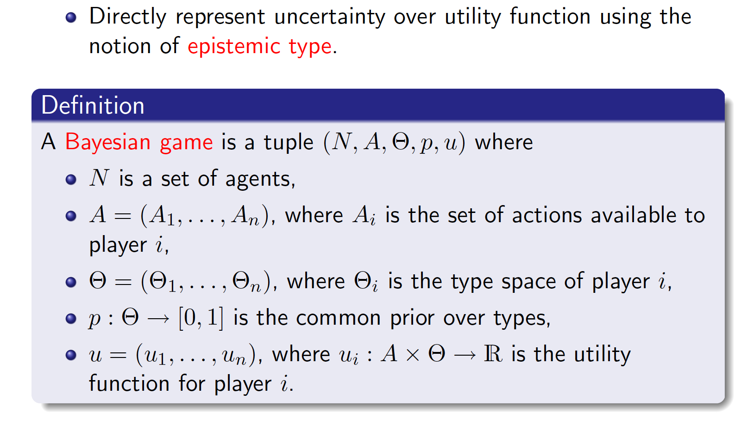
Player ”Types”

Slide 3
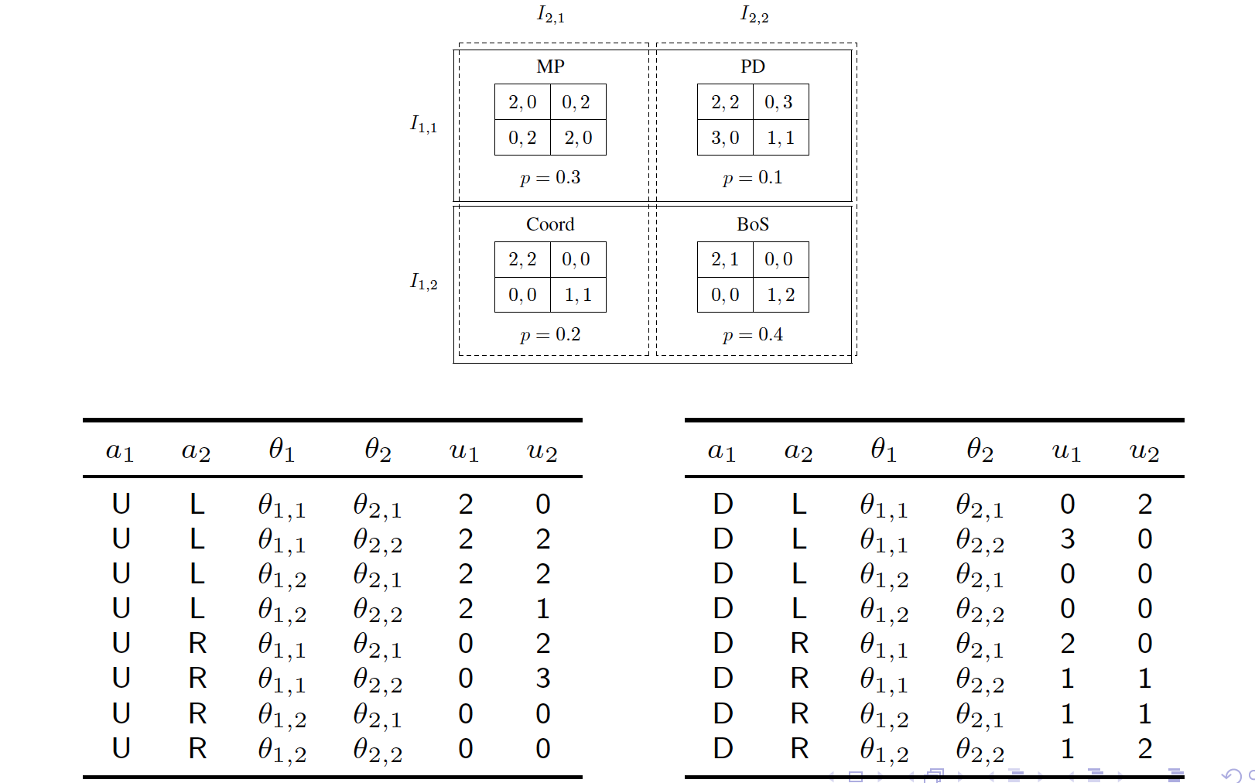
Example

Slide 4
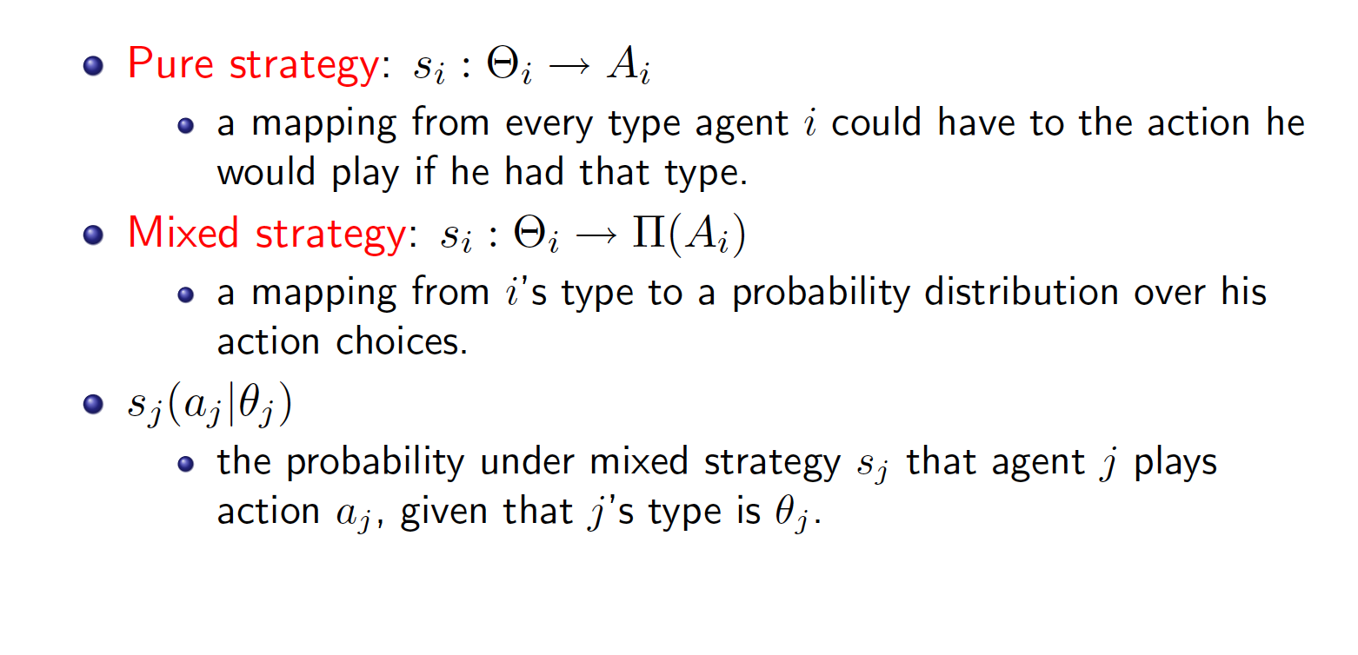
Strategies

Slide 5
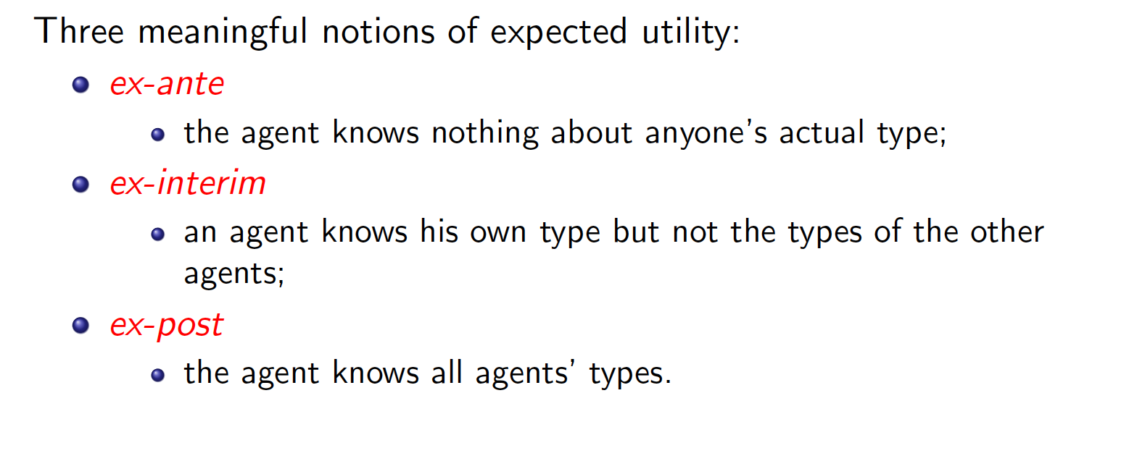
Expected Utility

Slide 6
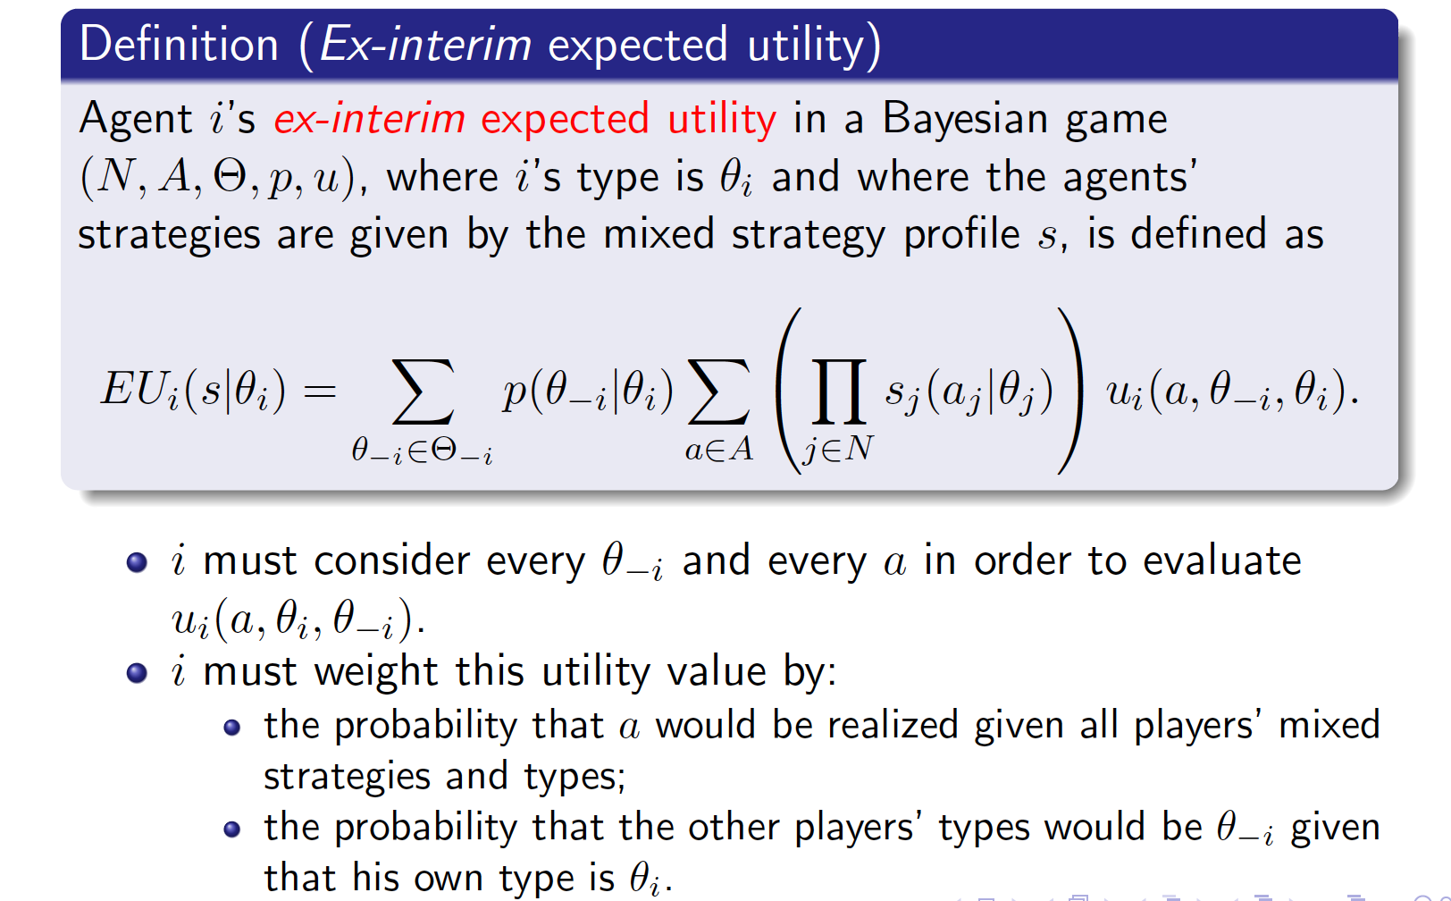
Ex-interim Expected Utility

Slide 7
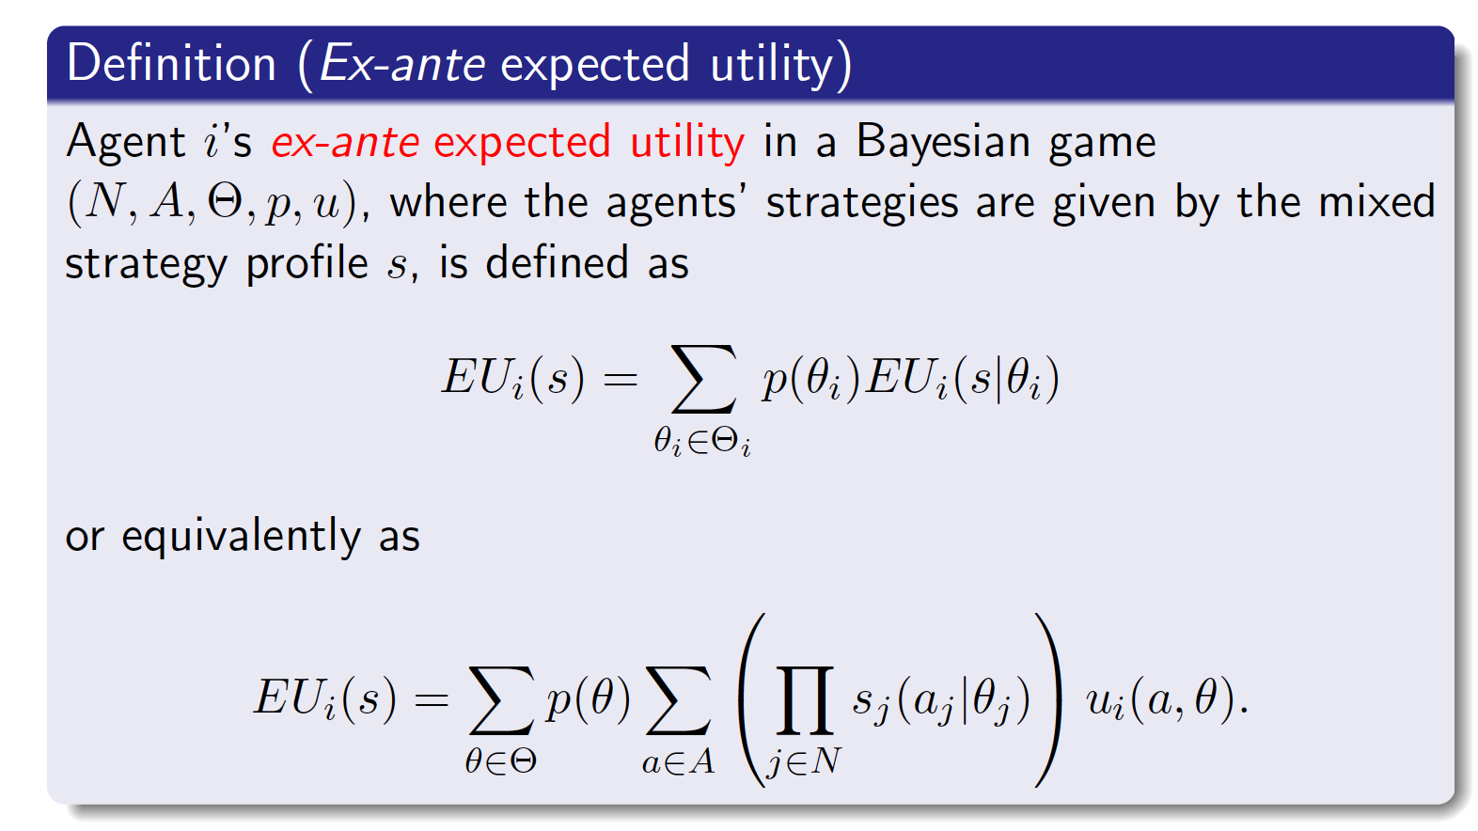
Ex-ante Expected Utility

Slide 8
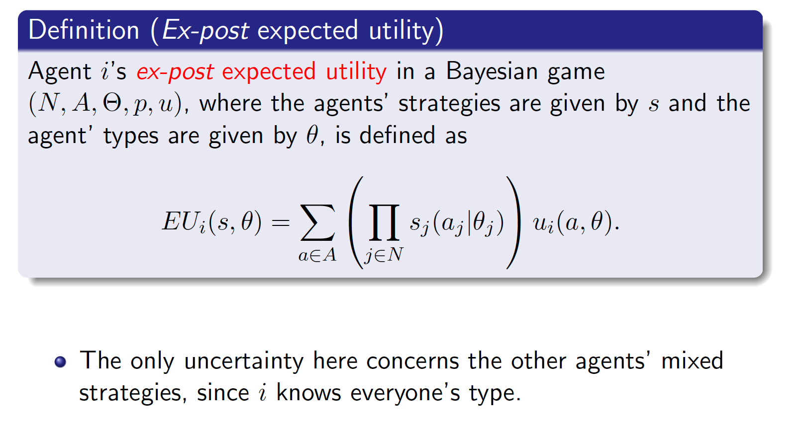
Ex-post Expected Utility

Slide 9
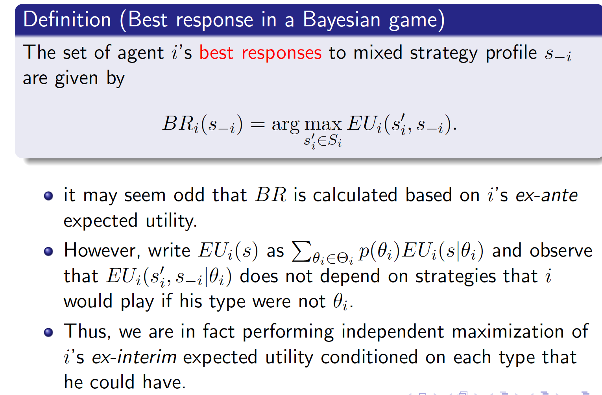
Best Response

Slide 10
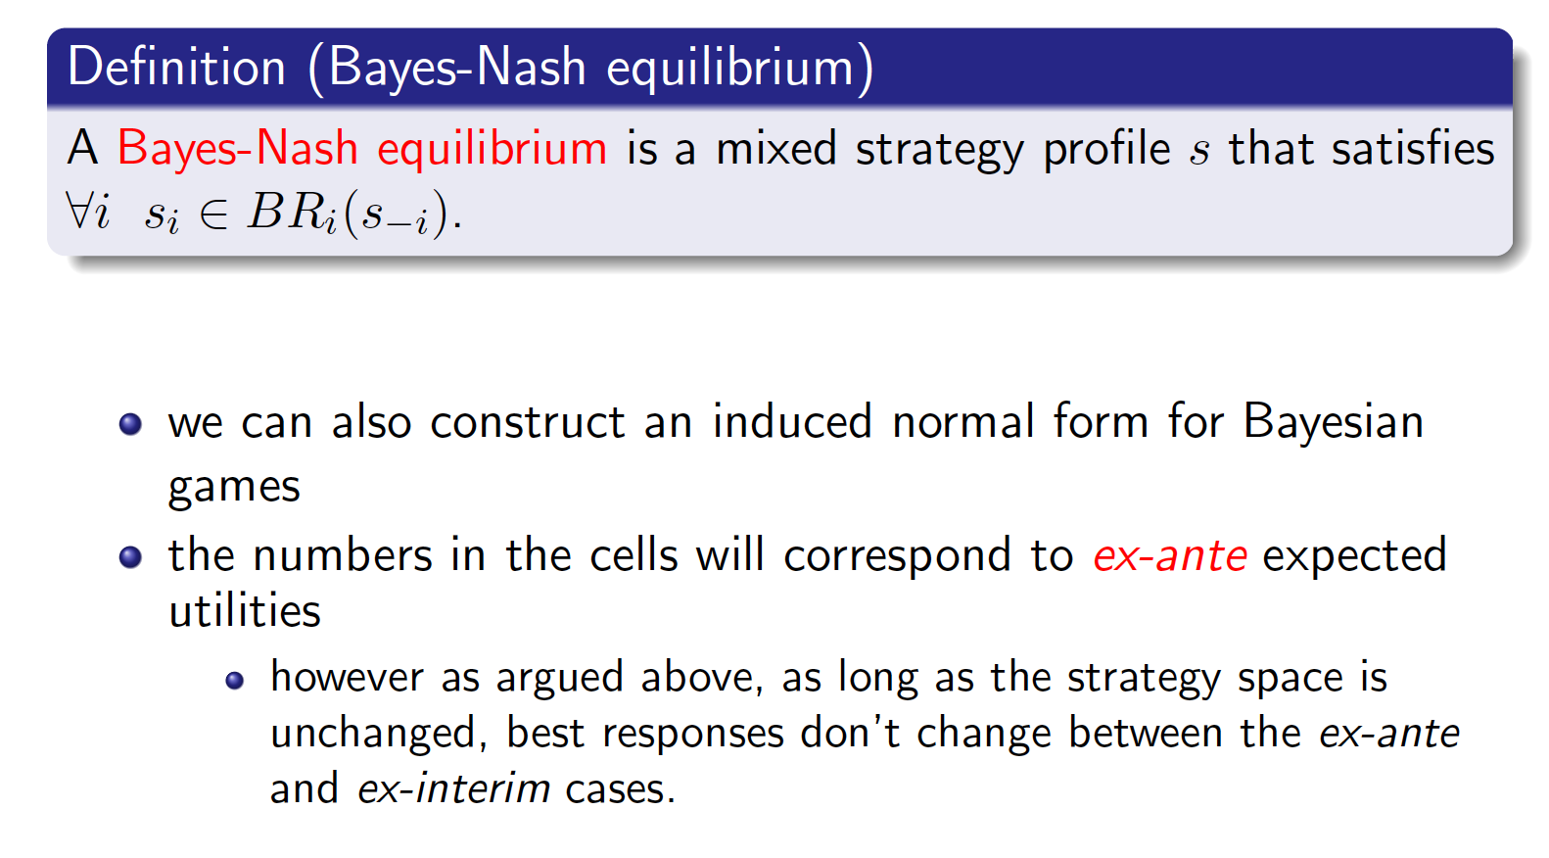
Nash Equilibrium

